Slide 1
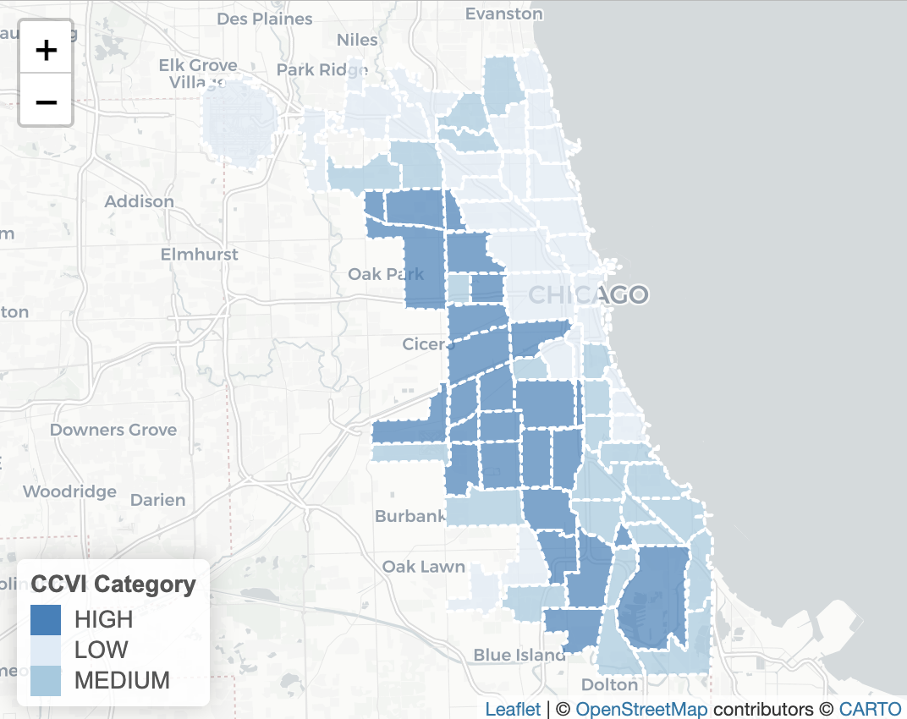
In the space below to copy/paste/insert a custom version (new color palette) of Figure 1 (map of CCVI Scores by Community Area) from the exercise.
GEO 3330 Sustainable Urban Transportation
Exercise #2: L Station Ridership Trends
Describe here any patterns you see in the map. Use data from the map to describe characteristics of at least one community located within each of the three CCVI categories.
Austin: Is one of the higher CCVI neighborhoods, with a CCVI score of 52.9 with vulnerability scores ranging from 28-63 of the vulnerability scale.
South Shore: Is one of the medium CCVI Neighborhoods, with a CCVI of 45.6, and vulnerability scores ranging from35-62.
Lincoln Park: Is one of the Low CCVI neighborhoods, with a CCVI of 7.3, with Vulnerability levels ranging from between 1-15.

Slide 2
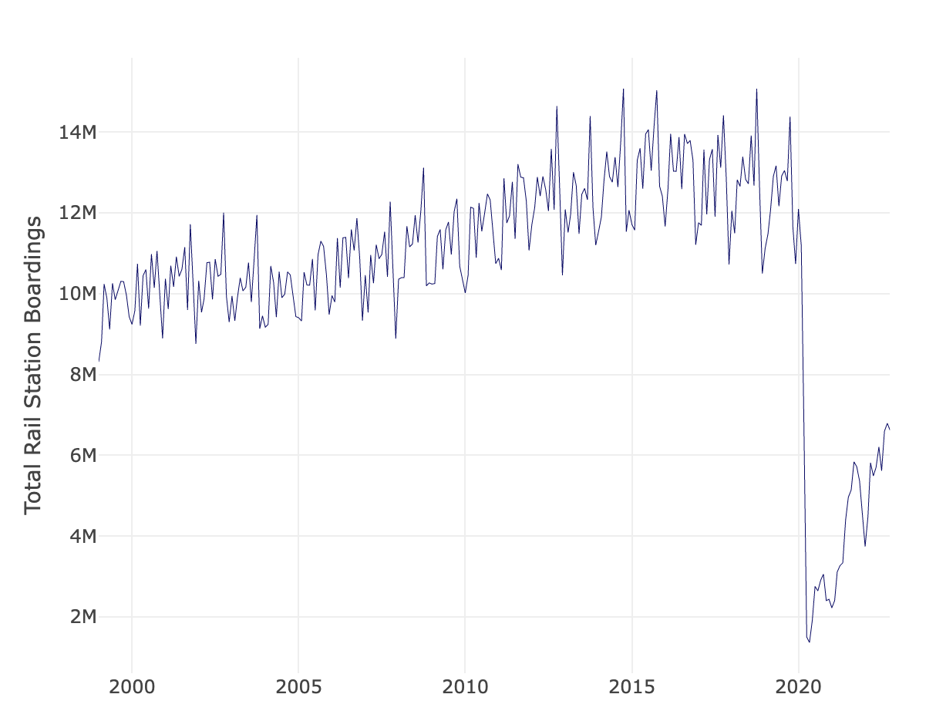
In the space below to copy/paste/insert Figure 2 or 3 from the exercise.
GEO 3330 Sustainable Urban Transportation
Exercise #2: L Station Ridership Trends
Describe patterns in rail boardings between 1999 and 2022. What do you think explains some of the cyclical variations in the data? What other factors may explain ridership over this period? Draw from the daily ridership plot to characterize ridership trends during the pandemic.
Up until 2020, we can see a pretty steady increase of rail boarding, and or use of railways, but it is in 2020 where we see a drastic drop in usage, most likely due to the pandemic, but now are starting to see a somewhat rapid increase in the use of rail boarding again

Slide 3
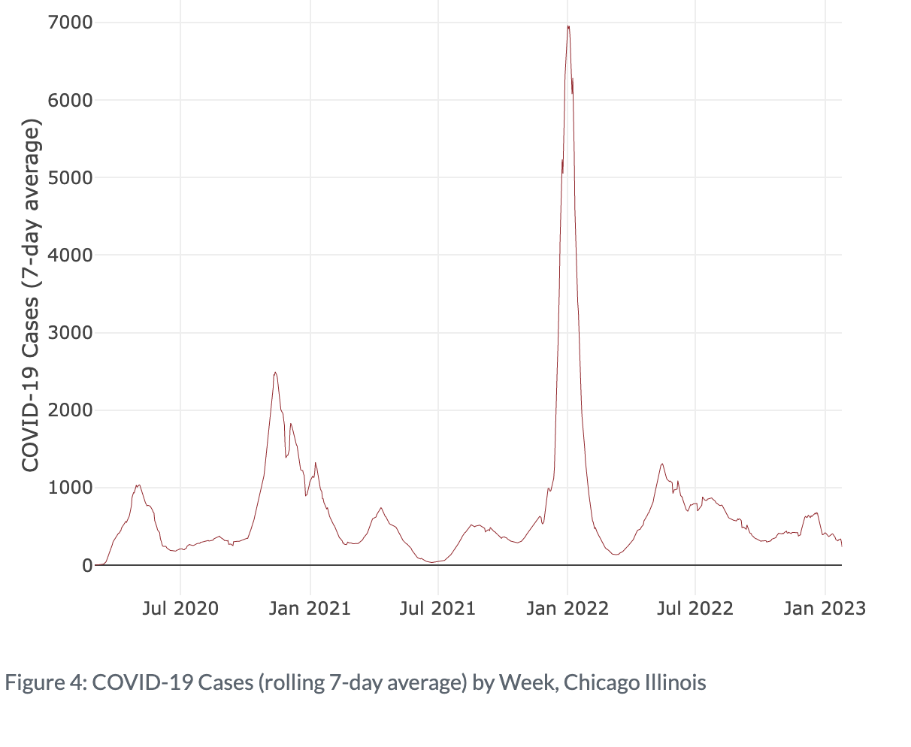
In the space below to copy/paste/insert Figure 4 from the exercise.
GEO 3330 Sustainable Urban Transportation
Exercise #2: L Station Ridership Trends
Are the waves and phases of the pandemic evident? Compare these pandemic phases to ridership trends over the same period. Do they appear to be related?
I believe that they are related, we see an increase in January 2022, which was a moment during the pandemic where people were coming back to school or work from vacation and the height of illness, combine that with usage of railroads. Being in tight areas during a height of illness will most likely cause a spike in cases.

Slide 4
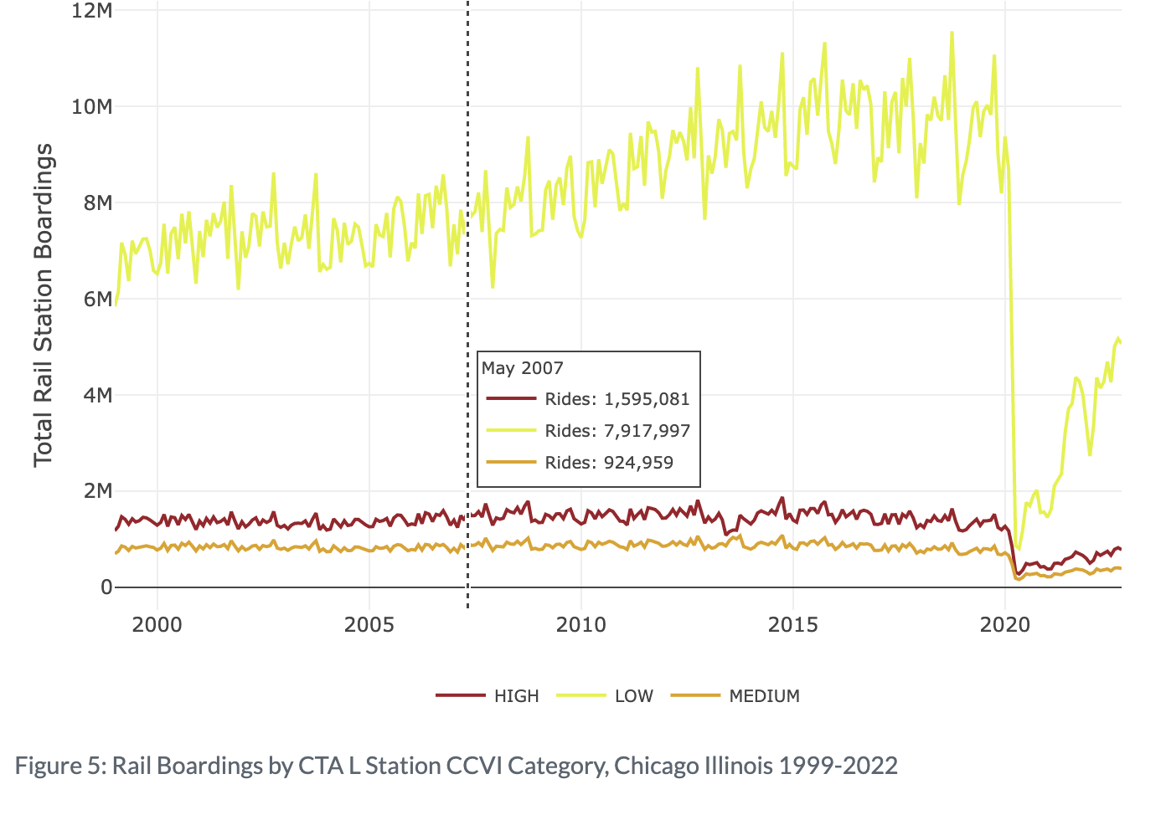
In the space below to copy/paste/insert Figure 5 or 6 from the exercise.
GEO 3330 Sustainable Urban Transportation
Exercise #2: L Station Ridership Trends
How does ridership vary with respect to station CCVI and line?
We can see a difference in usage before covid with different ride rates, but we can see an equal drop off as soon as covid hits and affects to CCVI, as all 3 lines basically flat line.

Slide 5
Summarize some potential short- and longer-term implications the pandemic has had on sustainable transportation and public transit ridership?
The pandemic affected Public transportation in a lot of ways, who it affected, cleanliness of trains, even shut it down, as in people stopped riding it.
People who relied on the transportation for work or errands didn’t have the luxury of transportation which impacted their ability to seek medical help if needed.
While long term it changed the way we look at cleanliness, trains and train stations try to be much cleaner than they were before.
GEO 3330 Sustainable Urban Transportation
Exercise #2: L Station Ridership Trends
What strategies do you propose to help return transit to pre-pandemic levels?
Running times, it seems that Covid may have impacted how the trains run, like being on time or leaving on time. This is important for people who rely on it for getting to jobs and other necessities on time. While it is due to shortness of staff, which is hard to fix it is also emphasizes the ideals of safety as well, people want to feel safe.

